Slide 1
14-15 Elementary/Secondary User Workshop
Welcome!
*Revised 9/16/2014

Slide 2
Agenda
Home Language Survey (Carmel)
191 Homeless Program Data Entry*
Birth Certificates and Aeries
TS Website
Exit Guide
Enrollment Checklist
Sibling Match*
Residence/Mailing Address Update
Primary Contact Entry
Teacher Table Maintenance (Fall 1)*
Other Programs in Aeries*

Slide 3
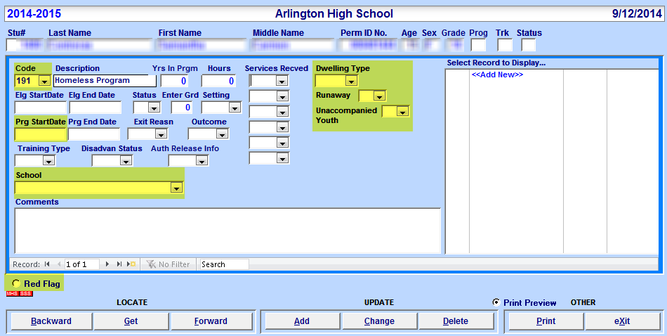
191 Homeless Program
Aeries CS
Required Data
1. Program Code
2. Dwelling Type
3. Runaway
4. Unaccompanied Youth
5. Prog Start Date
6. School
7. Red Flag
191 Code must be entered for Dwelling Type, Runaway, and Unaccompanied Youth options to become available
All highlighted fields must be populated for CALPADS
Prg End Date must be entered for students who move!

Slide 4
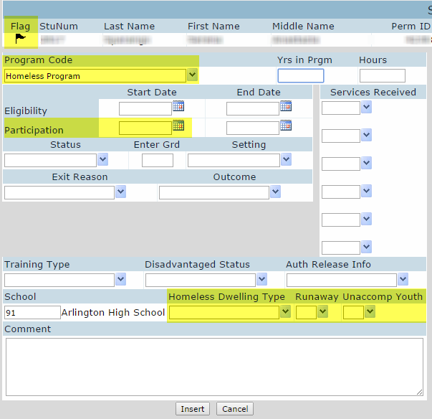
191 Homeless Program
Aeries.NET
Required Data
1. Red Flag
2. Program Code
3. Participation Start Date
4. Homeless Dwelling Type
5. Runaway
6. Unaccompanied Youth
191 Code must be entered for Dwelling Type, Runaway, and Unaccompanied Youth options to become available
All fields must be populated for CALPADS
END DATE must be entered for students who move!

Slide 5
191 Homeless Program
* Revised – Page Added
Query
Use this query to check your 191 Homeless Program data:
LIST STU PGM STU.TG STU.ID STU.NM PGM.CD PGM.PSD PGM.PED PGM.SCL PGM.HDT PGM.RA PGM.UY IF PGM.CD = 191 AND STU.TG # P AND STU.TG # N
Students with an Inactive tag need a Prg End Date in the 191 Homeless Program record.
The Prg End Date should be their last day of enrollment
Remove the Red Flag if 191 was their only program

Slide 6
Birth Certificates and Aeries
Names must be entered as shown on Birth Certificate
*Suffixes (Jr, II, III) must be entered into the Suffix field
No initials for Middle Name unless the Middle Name is an initial
Birth City and State must be entered as shown
No commas in the city field!
Birth Certificate
Last Name | Mc Knight Jr.
First Name | D’Angelo
Middle Name | William

Slide 7
TS Website
http://ts.rusd.edu/ or type TS in an internet address bar
Has all available Aeries documentation

Slide 8
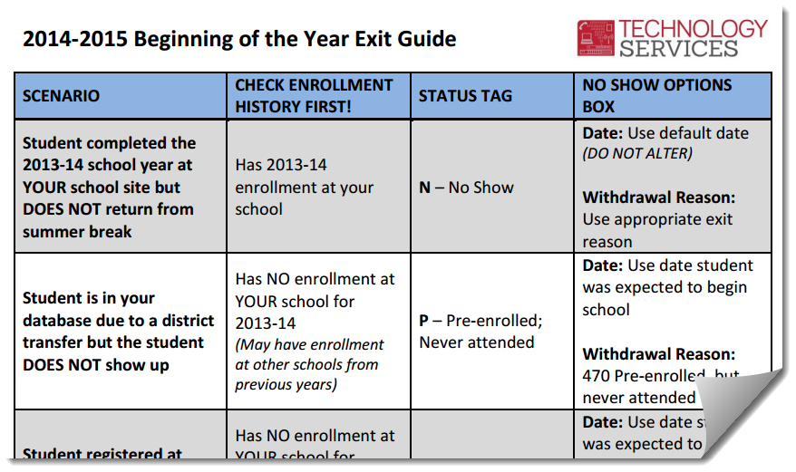
Exit Guide
All “N” No Show students should have an exit date of 6/11/14 or 6/12/14
QUERY: LIST STU TG ID NM GR LD IF TG = N
All “P” Pre-enrolled, Never Attended students should have an exit date of 8/22/2014 or 8/25/2014
Dates may differ if student enrolled after first day of school
QUERY: LIST STU TG ID NM GR LD IF TG = P
Notes:
For “P” students, day may differ if they enrolled after first day of school

Slide 9
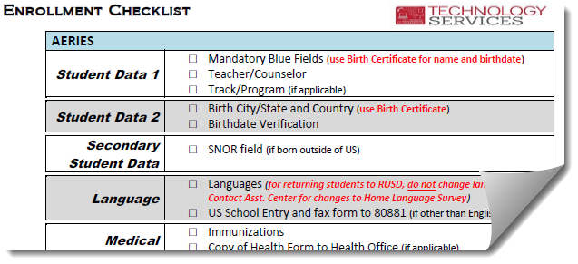
Enrollment Checklist
Use this as a guide to enter all necessary data for Aeries and CALPADS
Currently follows the CS (non-student enroll form) format.
To change settings in CS: View All Forms>Type: user>Enter>check or uncheck Student Enroll Form
Notes:
Other Forms>Variables>Aeries Variables for Current User>Student Enroll Form

Slide 10
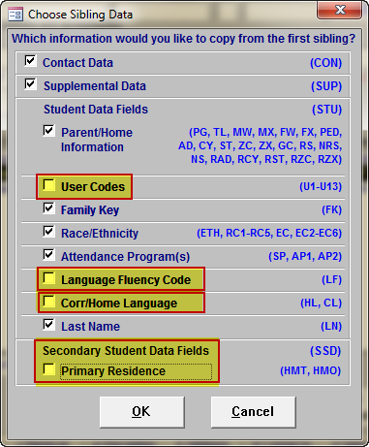
Sibling Match Aeries CS only
* Revised
When using sibling match, be sure to uncheck:
User Codes*
Language Fluency Code
Corr/Home Language
Primary Residence
After sibling has been created, please verify all data
Family Key
Verify all students in same family have same number
Notes:
.NET Transfer – Address, Parent Name, Parent Ed Lvl, Tel #, Correspondence Lang, and Contact Information

Slide 11
Residence/Mailing Address Update
Address Change vs. Fixing Bad Data
Aeries will default to Address Change
Address Change – used to update a student’s address when the student moves
Fixing Bad Data – used only if current address needs to be edited
Why is your choice important?
CALPADS is watching!

Slide 12
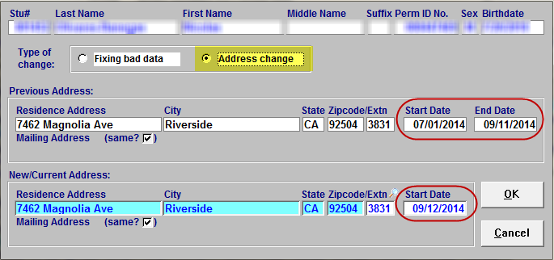
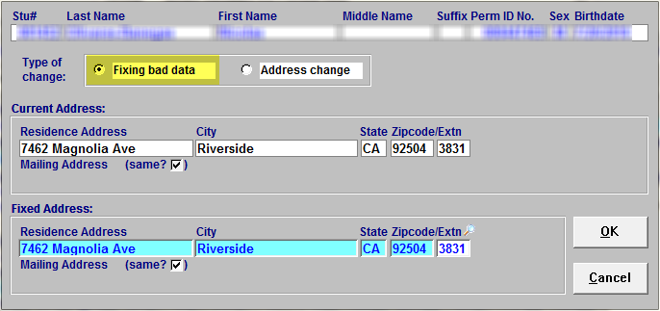
Residence/Mailing Address Update (cont.)
Address Change
Fixing Bad Data
NEW dates in CALPADS
NO changes to CALPADS

Slide 13
Residence/Mailing Address Update (cont.)
Address Change
NEW dates in CALPADS
Fixing Bad Data
NO changes to CALPADS

Slide 14
Residence/Mailing Address Update (cont.)
Students Missing Residence School Information
Students should have a Res School in Aeries (except students on Inter-district transfers)
Run this query: LIST STU ID NM RS IT IF RS = 0 AND IT = “ “
Check address for students who are listed on this query. They are either:
On an inter-district transfer and missing their Transfer Info. (Araceli Zavala) OR
There was a data entry error when entering/editing an address
These students’ information must be corrected!

Slide 15
Primary Contacts
Student Data 1
Use these fields to list most important phone numbers
Aeries CS
Aeries.NET

Slide 16
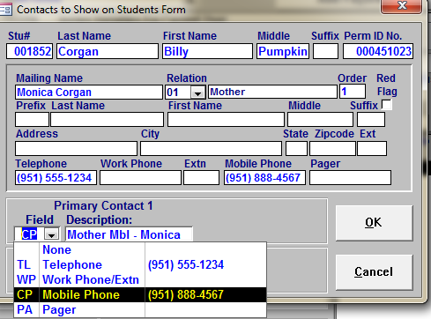
Primary Contact Entry (cont.)
Aeries CS
Open Contacts
Highlight the person you’d like to assign as a Primary Contact
Click on Link (bottom right)
Choose Field (#) you would like to assign
Description field can be edited
Stu Data 1

Slide 17
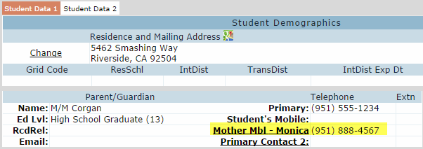
Primary Contact Entry (cont.)
Aeries.NET
Click on Primary Contact 1 or 2 from Student Data 1
Highlight the person you’d like to assign as a Primary Contact
Click on Link (bottom right)
Choose Field (#) you would like to assign
Description field can be edited
Stu Data 1

Slide 18
Teacher Table Maintenance Things to remember
* Revised
Teachers in your 14-15 teacher table that are no longer physically on campus and DID NOT start teaching this school year can be deleted or inactivated*
DO NOT delete/inactivate Teacher 0
No teacher names of Vacancy, Science Teacher, 3rd Grade Teacher
Any staff member, including Classified, can have a teacher record
Used for Assertive Discipline
All certificated staff should have Staff ID number populated
Teachers that do not have students assigned, use Website field to enter Job Title
Special Ed teachers = 800’s
Home Hospital teachers = 500’s

Slide 19
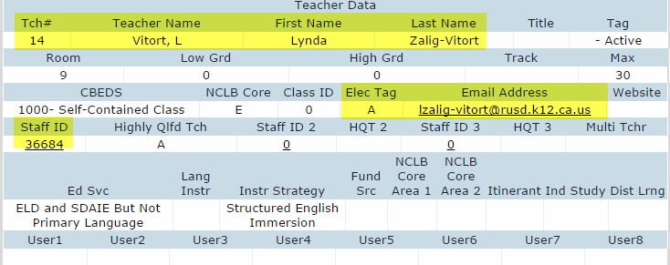
Teacher Table Maintenance (cont.)
CS
.NET

Slide 20
Special Programs
* Revised
All levels
~504 Accommodation Plan (101)
Foster Program (190)*
~Homeless Program (191)
Elementary
DLI Program (DLI)
~Transitional Kindergarten (185)
Secondary
ASB (810)
AVID (160)
Cal-SAFE (162)*
~California Partnership Academy (113)
CSF (815)
~Opportunity (108)
Puente (850)
ROTC (860/862/864/866)
~CALPADS Programs
Be sure to use Prog. Participation Start/End Dates

Slide 21
If you need assistance, please open a work order ☺

Slide 22
Help Desk Support & Training
To Open a Work Order or for General Support:
http://nisworks/
Extension 81099
To Enroll in Technology Services Support Training:
https://remote.rusd.k12.ca.us/TechnologyTraining/
To Access Aeries Documentation:
http://ts.rusd.edu/
Documentation>Aeries Student Systems

